Slide 1
Chapter 18
Regular Expressions in Python

Slide 2
List of contents
Regular Expressions
Sequence Characters in Regular Expressions
Quantifiers in Regular Expressions
Special Characters in Regular Expressions
Using Regular Expressions on Files
Retrieving Information from a HTML File

Slide 3
Introduction
Many a times, we are needed to extract required information from given data.
For example, we want to know the number of people who contacted us in the last month through Gmail or we want to know the phone numbers of employees in a company whose names start with 'A' or we want to retrieve the date of births of the patients in a hospital who joined for treatment for hypertension, etc.
To get such information, we have to conduct the searching operation on the data.
Once we get the required information, we have to extract that data for further use.
Regular expressions are useful to perform such operations on data.
Let's learn more about regular expressions.

Slide 4
Regular Expressions
A regular expression is a string that contains special symbols and characters to find and extract the information needed by us from the given data.
A regular expression helps us to search information, match, find and split information as per our requirements.
A regular expression is also called simply regex.
Regular expressions are available not only in Python but also in many languages like Java, Perl, AWK, etc.
Python provides re module that stands for regular expressions. This module contains methods like compile(), search(), match(), findall(), split(), etc. which are used in finding the information in the available data. So, when we write a regular expression, we should import re module as:
import re
A simple regular expression may look like this:
reg = r'm\w\w'

Slide 5
In the preceding line, the string is prefixed with 'r' to represent that it is a raw string. Generally, we write regular expressions as raw strings. Let's understand why this is so. When we write a normal string as:
str = ‘This is normal\nstring’
Now, print(str) will display the preceding string in two lines as:
This is normal
string
Thus the ‘\n' character is interpreted as new line in the normal string by the Python interpreter and hence the string is broken there and shown in the new line. In regular expressions when ‘\n' is used, it does not mean to throw the string into new line. There ‘\n' has a different meaning and it should not be interpreted as new line. For this purpose, we should take this as a 'raw' string. This is done by prefixing 'r' before the string.
str = r’This is raw\nstring’
When we display this string using print(str), the output will be:
This is raw\nstring

Slide 6
So, the normal meaning of ‘\n’ is escaped and it is no more an escape character in the preceding example. Since ‘\n' is not an escape character, it is interpreted as a character with different meaning in the regular expression by the Python interpreter. Similarly, the characters like ‘\t’, '\w', ‘\c', etc. should be interpreted as special characters in the regular expressions and hence the expressions should be written as raw strings.
If we do not want to write the regular expressions as raw strings, then the alternative is to use another backslash before such characters. For example, we can write:
reg = r’m\w\w’ # as raw string
reg = ‘m\\w\\w’ # as normal string
But using backslashes like this may be confusing for the programmer.
Now, let's go back to our first regular expression:
reg = r’m\w\w’
This expression is written in single quotes to represent that it is a string. The first character 'tn' represents that the words starting with 'm' should be matched. The next character Aw' represents any one character in A to Z, a to z and 0 to 9. Since we used two Aw' characters, they represent any two characters after 'm'. So, this regular expression represents words or strings having three characters and with 'm' as first character. The next two characters can be any alphanumeric.

Slide 7
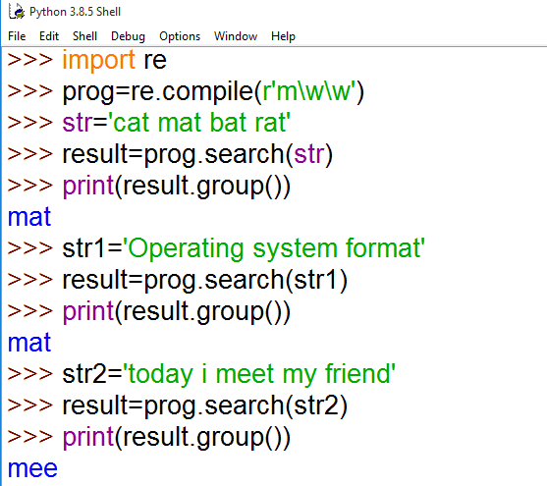
Yes, we developed our first regular expression! The next step is to compile this expression using..compile() method of 're' module as:
prog = re.compile(r'm\w\w')
Now, prog represents an object that contains the regular expression. The next step is to run this expression on a string `str' using the search() method or match() method

Slide 8
Instead of this two statements
prog = re.compile(r'm\w\w')
result = prog.search(str)
We can go with single line code
result = re.search(r'm\w\w', str)
So, the general form of writing regular expressions is as follows:
result = re.search('expression', 'string')
There is another method by the name match() that returns the resultant string only if it is d in the beginning of the string.
There is a method split() that splits the given string into pieces according to the regular expression and returns the pieces as elements of a list.
Some regular expressions can also be used to find a string and then replace it with a new string. For this purpose, we should use the sub() method of 're' module. The format of this method is:
sub(regular expression, new string, string)
Go to Jupyter notebook for examples

Slide 9
So, regular expressions are used to perform the following important operations
Matching strings
Searching for strings
Finding all strings
Splitting a string into pieces
Replacing strings

Slide 10
The following methods belong to the 're' module that are used in the regular expressions:
The match() method searches in the beginning of the string and if the matching string is found, it returns an object that contains the resultant string, otherwise it returns None. We can access the string from the returned object using group() method.
The search() method searches the string from beginning till the end and returns the first occurrence of the matching string, otherwise it returns None. We can use group() method to retrieve the string from the object returned by this method.
The findall() method searches the string from beginning till the end and returns all occurrences of the matching string in the form of a list object. If the matching strings are not found, then it returns an empty list. We can retrieve the resultant strings from the list using a for loop.
The split() method splits the string according to the regular expression and the resultant pieces are returned as a list. If there are no string pieces, then it returns an empty list. We can retrieve the resultant string pieces from the list using a for loop.
The sub() method substitutes (or replaces) new strings in the place of existing strings. After substitution, the main string is returned by this method.

Slide 11
Sequence Characters in Regular Expressions
Sequence characters match only one character in the string. Let's list out the sequence characters which are used in regular expressions along with their meanings in the following table
Go to Jupyter notebook for examples
Character | Its description
\d | Represents any digit ( 0 to 9)
\D | Represents any non-digit
\s | Represents white space. Ex: \t \n \r \f \v
\S | Represents non-white space character
\w | Represents any alphanumeric (A to Z, a to z, 0 to 9)
\W | Represents non-alphanumeric
\b | Represents a space around words
\A | Matches only at start of the string
\Z | Matches only at end of the string

Slide 12
Quantifiers in Regular Expressions
In regular expressions, some characters represent more than one character to be matched in the string. Such characters are called 'quantifiers'.
For example, if we write ‘+’ it represents l or more repetitions of the preceding character. Hence, if we write an expression as: r' \d+', this indicates that all numeric digits which occur for 1 or more times should be extracted.
Go to Jupyter notebook for examples
Character | Its description
+ | 1 or more repetitions of the preceding regexp
* | 0 or more repetitions of the preceding regexp
? | 0 or 1 repetitions of the preceding regexp
{m} | Exactly m occurrences
{m,n} | From m to n, m defaults to 0. n to infinity

Slide 13
Special Characters in Regular Expressions
Characters with special significance shown in the following Table can be used in regular expressions. These characters will make our searching easy.
Go to Jupyter notebook for examples
Character | Its Description
\ | Escape special character nature
. | Matches any character except new line
^ | Matches beginning of a string
$ | Matches ending of a string
[…] | Denotes a set of possible characters. Ex: [6b-d] matches any characters '6', 'b', 'c' or 'd'
[^...] | Matches every character except the ones inside brackets. Ex: [^a-c6] matches any character except 'a', 13', 'c' or '6'
(...) | Matches the regular expression inside the parentheses and the result can be captured.
R|S | Matches either regex R or regex S

Slide 14
Using Regular Expressions on Files
We can use regular expressions not only on individual strings, but also on files where huge data is available.
As we know, a file contains a lot of strings.
We can open the file and conduct searching or matching etc. operations on the strings of the file using regular expressions
Go to Jupyter notebook for examples

Slide 15
Retrieving Information from a HTML File
In python we can apply regular expressions on a HTML file and retrieve the necessary information.
Go to Jupyter notebook for examples

